Slide 1
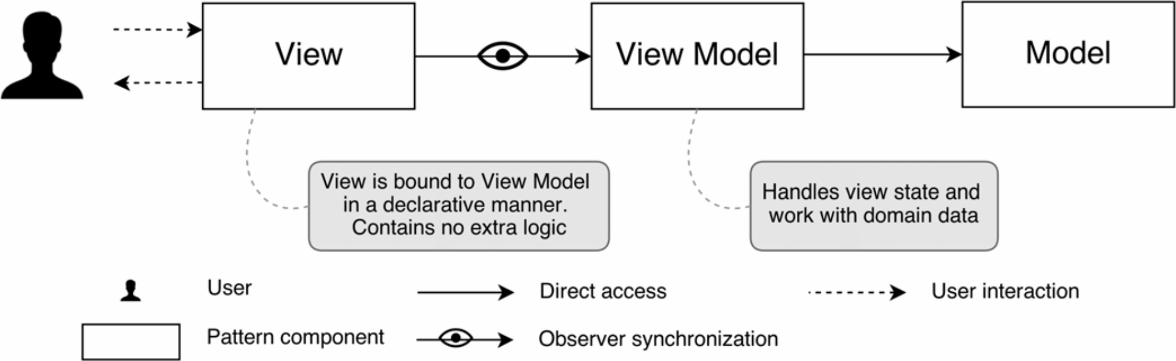
GPS_Frontend
User Interface to interact with GPS_Tracker
Single Page Application (SPA)
Based on web technologies
Main features
Model-View-ViewModel design pattern
Parallel execution, asynchronous calls
Reactivity
Extensibility
Representation of MVVM design pattern elements
Notes:
Now we will discuss the most visual part of our framework – GPS_Frontend.
This is a web based user interface to access link measurement data from mobile phones. Also it provides functions to run optimization tasks and analyze result of them.
User Interface built with Model-View-ViewModel design pattern shown on the slide.
Here we have three components:
View – objects shown to user, like tables, div, columns, images.
ViewModel – component that defines operation on data representing in Model. May separate partly data contract with Model component.
Model – storage for user data. There are specified getters and setters for data objects. All data sink communication (to external DB, local DB, different transformation) defined here.

Slide 2



Technologies for GPS_Frontend
Components
VueJS – a Javascript framework for SPA
Vuex – data storage library
Vuerouter – URL path router
Plotly – plotting library
Bootstrap – web design library
Alternatives
Angular – by Google, functional, but monolithic
React – by Facebook, flexible, but not easy-to-go
VueJS – by community, flexible, lightweight, but not so functional
The most popular libraries logos for modern web projects: Angular, React, VueJS
Notes:
We can point out 5 technologies in GPS_Frontend
- VueJS - a Javascript web framework, the skeleton of application
- Vuex - a unite data storage to share between components
- Vuerouter - URL path routing
- Plotly - to plot figures
- Bootstrap - an open-source toolkip, to make UI good looking.
- Angular has rich functionality, but too complex for that task.
- React is more fexible, but requires more time to get working in.
- Vue.js is a simple framework with an excellent documentation but has a lack of components in the default conguration. It requires additional libraries and components to design required functions.

Slide 3
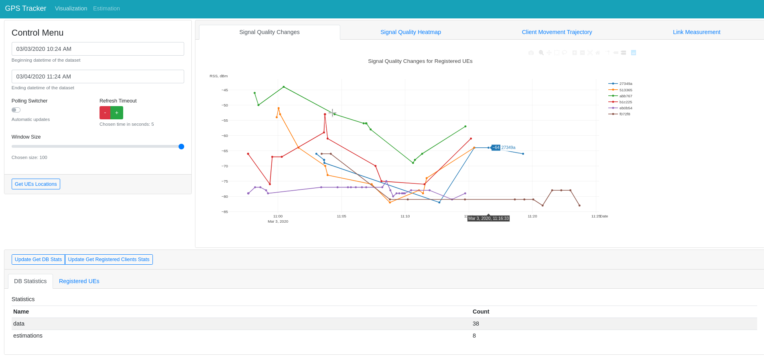
GPS_Frontend-Visualization
Timeframe,
update
frequency
configuration
Location data on given
timeframe
Database
statistics
Layout of the UI implemented by GPS_Frontend. The user access UI in a web-browser
Notes:
This is a view where you can show and analyze measurements received from the phone.
Control Menu
Database Statistics
Graphical View
Signal Changes
Signal Heatmap
Client Measurement Technology
Link throughput Measurements

Slide 4
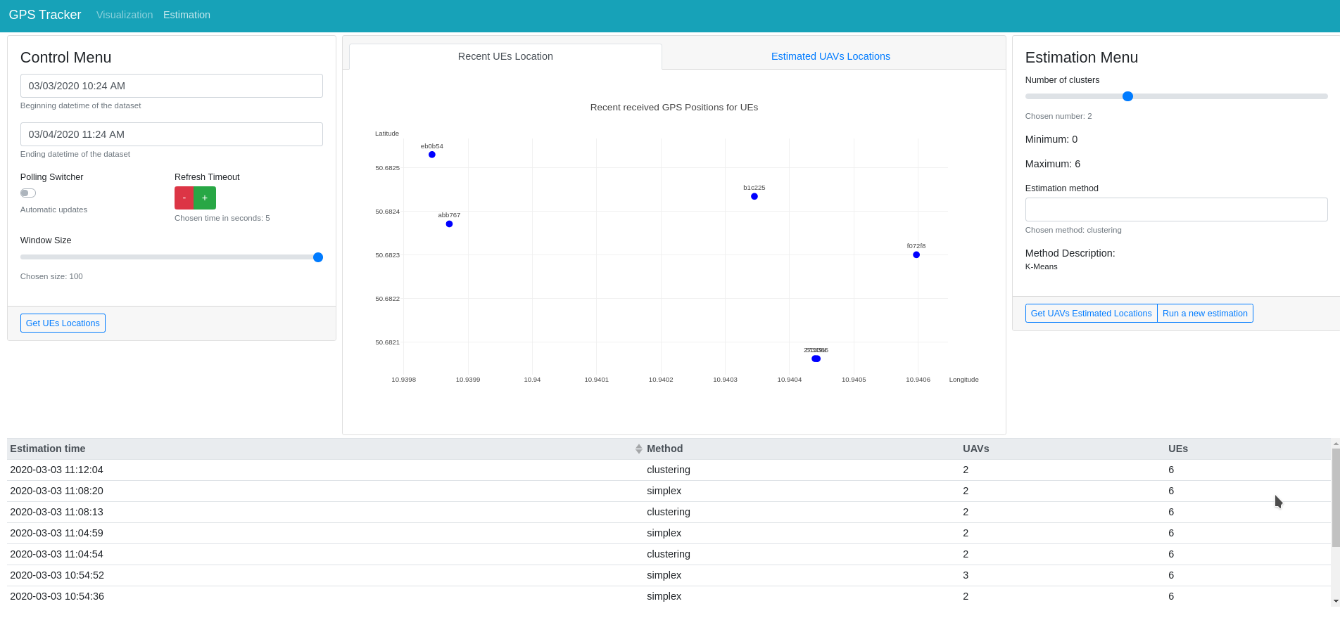
GPS_Frontend-Estimation
UEs positions for optimization task
Choose parameters for new task
Available task results
Notes:
This is another view of GPS_Frontend where you work with placement opltimication algorithms
Control Menu
Estimation Menu
Available Estimation Results

Slide 5
GPS_Tracker
Functions
Serve HTTP REST inquires
Process incoming messages from GPS_Android
Dispatch optimization tasks
Key features
Worker design pattern
Python programming language
Key technologies
Lightweight Flask library for HTTP server
Celery task scheduling library
MongoDB NoSQL database
RabbitMQ message queue
Notes:
Then we are going to discuss our backend part called GPS_Tracker.
This is set of backend programs intended to serve user requests, process incoming messages from GPS_Androi and perform optimization tasks.
The GPS Tracker is implemented in Python language. This is a dynamic interpreting language. That is known the performance is not so perfect compared to
static compiled languages, but it has higher changeability property.

Slide 6
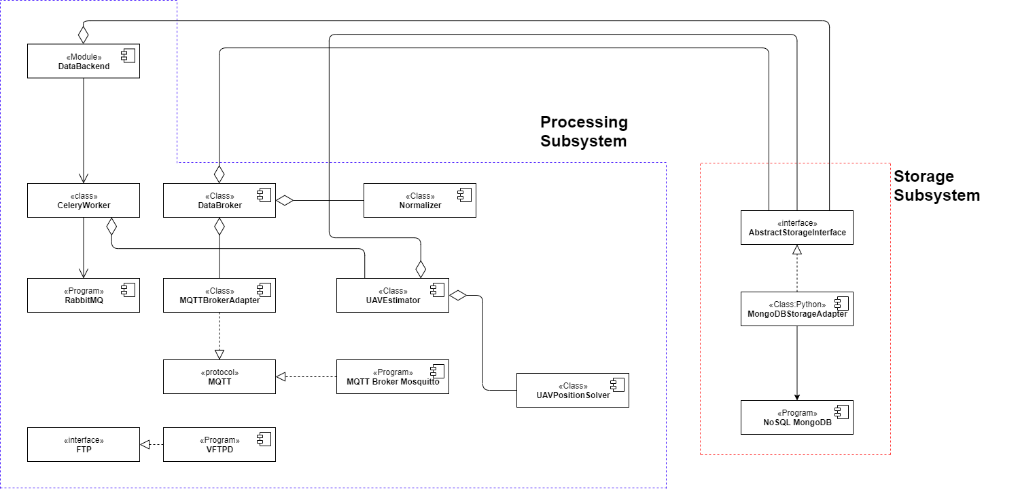
GPS_Tracker Subsystems
Component Diagram for GPS_Tracker subsystems
Notes:
This s component diagram of GPS_Tracker
I would like to point out two subsystem
Processing Subsystem
FTP
MQTT (with middleware) or DataBackend
Storage Subsystem
Interface
MongoDB

Slide 7
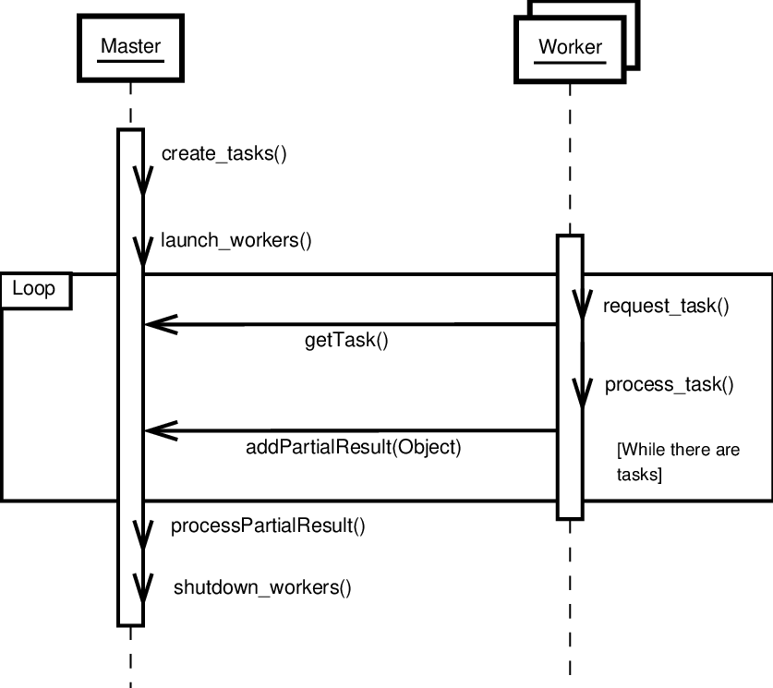
Master-Worker Interaction Diagram
A typical interaction diagram for Worker design pattern
Notes:
Speaking about Worker design pattern, it provides useful architecture:
- Linear performance scaling
Load balancing
Fast feedback to users

Slide 8
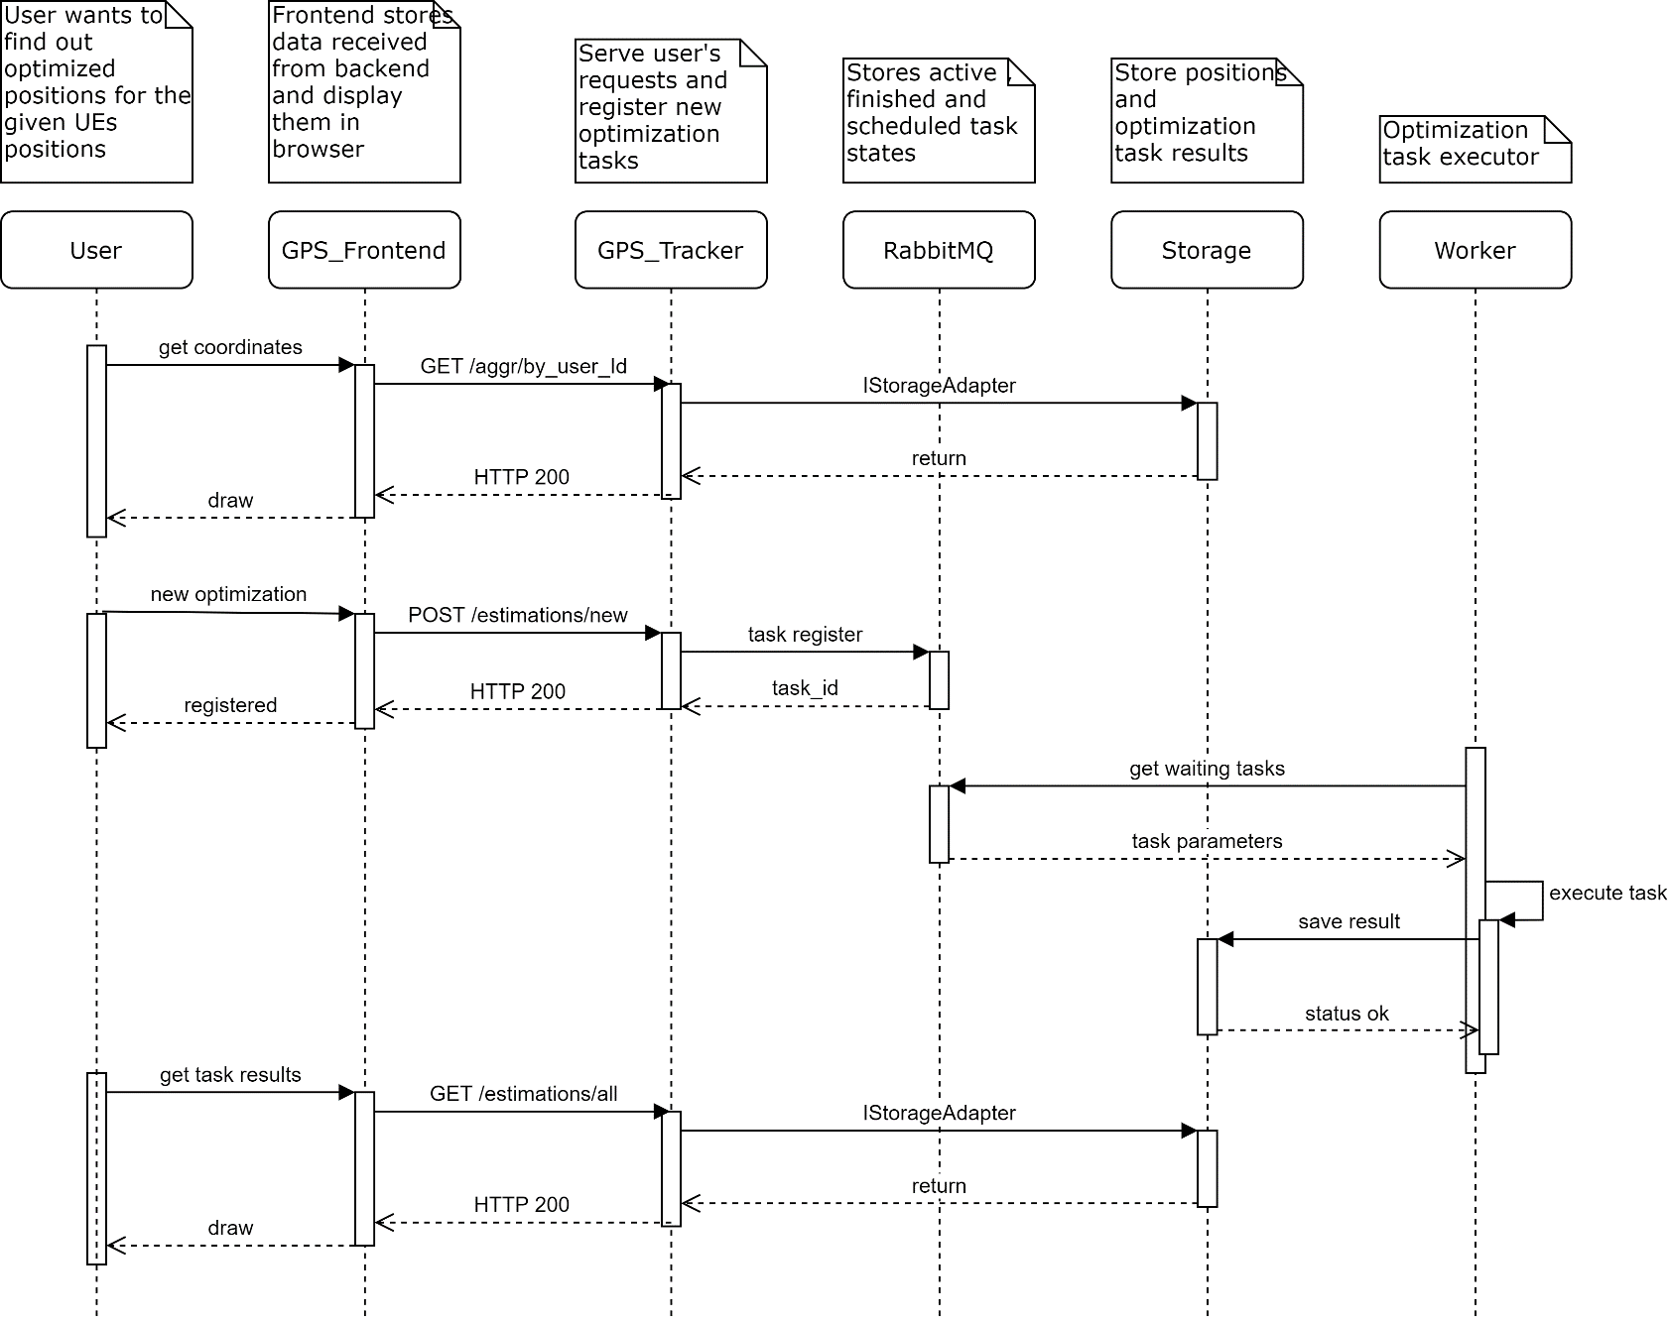
UI And Backend Interaction
New optimization task registration
Notes:
Now I would like to discuss one of the most interesting features implemented in GPS_Tracker.
Optimization tasks can take long to complete, and if we start optimization task in the same thread that serving a user request, it will hand the user until the task is done. To make UI responsible and interactive, we use Python Celery library to implement Worker pattern when performing an optimization task.

Slide 9
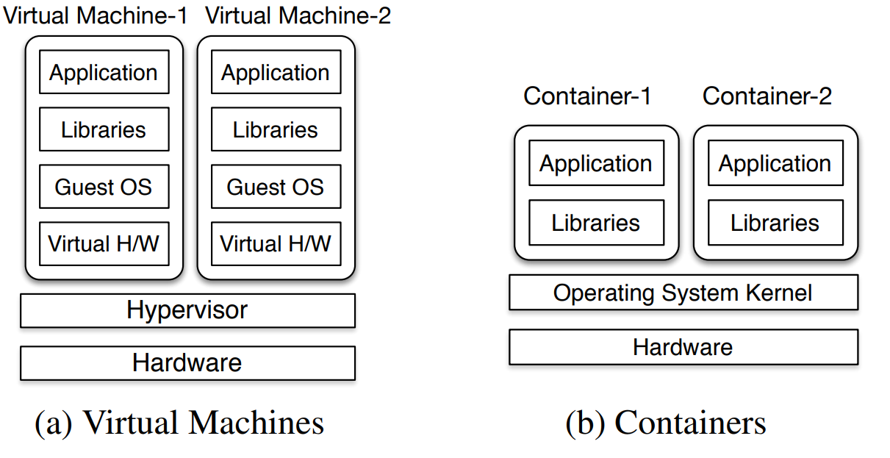
System Component Deployment
Two main cases
Bare-metal installation
Containerized deployment
Key features
Interaction via network
Components can be separated geographically
Virtual machines and containers runtime
Reason for virtual machines
Independence of hardware
Virtual hardware specification control
Single way of installation – just bring an VM image
Reason for containers
Provide ready-to-use program environment
Concept isolation – explicit specification of dependencies
Resource isolation – cgroups and namespaces
Convenient development and deployment
Abstraction Layers for Hardware and Operation system virtualization
Notes:
Another interesting thins is the deployment process of our framework.
We provide flexible way to install and run the system – you can use real hardware that gives you the maximum performance, or you can use containerized environment.
We provide already prepared virtual machine image, where software components are running in containers.
There are pros and cons when your add so many run-time abstraction, but nevertheless, advantages outweighs possible problems.

Slide 10
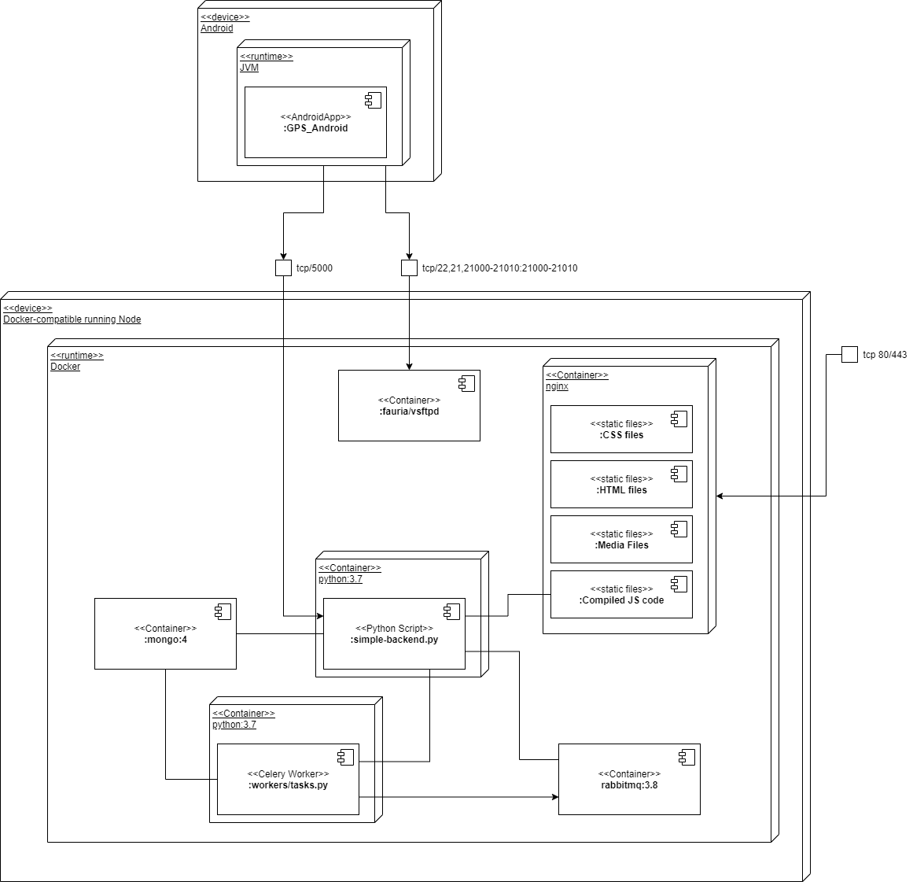
Deployment Diagram In Containers
Notes:
Finally, you can see deployment plan using containers.
We have three entry points:
Tcp 80/443 – to access web interface.
Tcp 5000 – to access REST API
Tcp 21 – to access FTP to perform link throughput measurements
Internally, Docker (a set of platform to run OS-level virtualization – container) set-up overlay network for containers and take care of correct routing between them. Therefore, as long as your containers are running in the same machine or cluster, you don’t have to worry about network connectivity.

Slide 11
References
A. Syromiatnikov and D. Weyns, "A Journey through the Land of Model-View-Design Patterns," 2014 IEEE/IFIP Conference on Software Architecture, Sydney, NSW, 2014, pp. 21-30. doi: 10.1109/WICSA.2014.13
Ropero, Juan & Tamura, Gabriel. (2017). Characterizing the Impact of Context-Variables in Software Performance Factors: a Domain-Specific Design Patterns Perspective. 10.13140/RG.2.2.13879.42408.
Prateek Sharma, Lucas Chaufournier, Prashant Shenoy, and Y. C. Tay. 2016. Containers and Virtual Machines at Scale: A Comparative Study. In Proceedings of the 17th International Middleware Conference (Middleware ’16). Association for Computing Machinery, New York, NY, USA, Article 1, 1–13.

